Slide 1
Net Promoter Score
DA plus_07 student, Yuliya Yeusiyevich
19.04.2022

Slide 2
Table of contents
Project concept
About data
Evaluation of results
Questions
Dashboard analysis

Slide 3
Project concept
We have the results of a customer survey of a large telecom company that provides services across the CIS.
We will analyze customer loyalty, or NPS (Net Promoter Score).

Slide 4
A classic question was asked:
«How likely are you to recommend our services to a friend or an acquaintance?».
Results are presented in a dynamic dashboard format.

Slide 5
About data
the information is uploaded by the company using SQLite as related database tables;
501,152 people were surveyed;
survey country – Russian Federation;
number of cities involved - 62;

Slide 6
Evaluation of results
Clients are usually divided into three groups (based on scores):
score 9-10 —promoters;
score 7-8 — passives;
score 0-6 —detractors.

Slide 7
NPS calculation
NPS value is derived using the formula:
% of promoters - % of detractors

Slide 8
How are survey respondents divided by sex and age?
How many new and existing users do we have?
What cities were the most active in the survey?
Questions

Slide 9
Which user groups have the greatest loyalty to this service?
Which groups are less loyal?
What is the total NPS?
How promoters can be described?
Questions

Slide 10
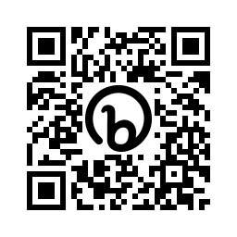
Interactive dashboard

Slide 11
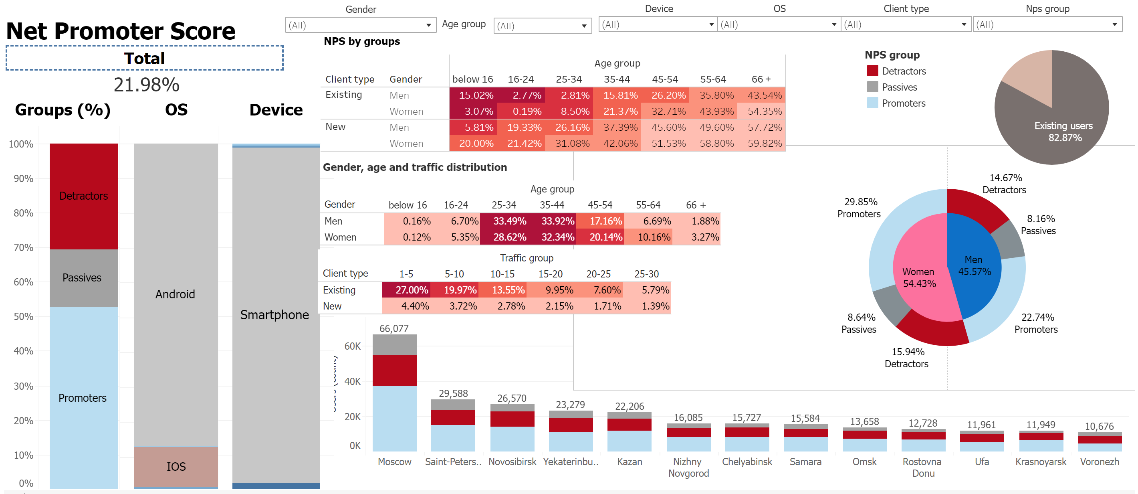
11

Slide 12

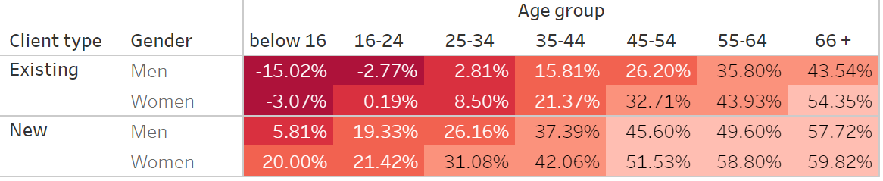
Total NPS:
NPS by gender and age (new\existing users)

Slide 13
total NPS is 21.97%;
a positive index indicates that the majority of customers are loyal to the company, its clientele can grow on its own;
the value below 30 is not a good enough result, work with the clients base is necessary;
more loyal groups:
- new customers
- women
- older people (direct proportion between age and score).
Conclusions:

Slide 14
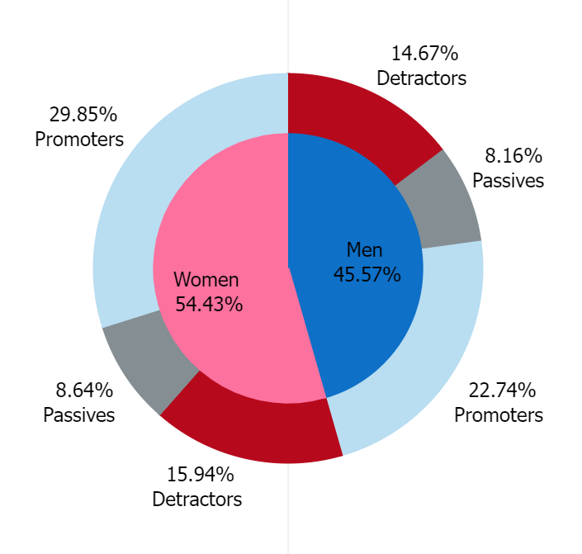
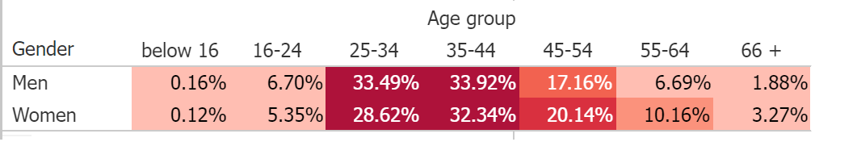
Respondents' gender and age distribution

Slide 15
there is a similar proportion of men and women;
main age groups: 25-34 and 35-44 for both men and women;
the distribution of user groups according to their scores (promoters, detractors, passives) is roughly the same for men and women
but the loyalty of women is slightly higher;
Conclusions:

Slide 16
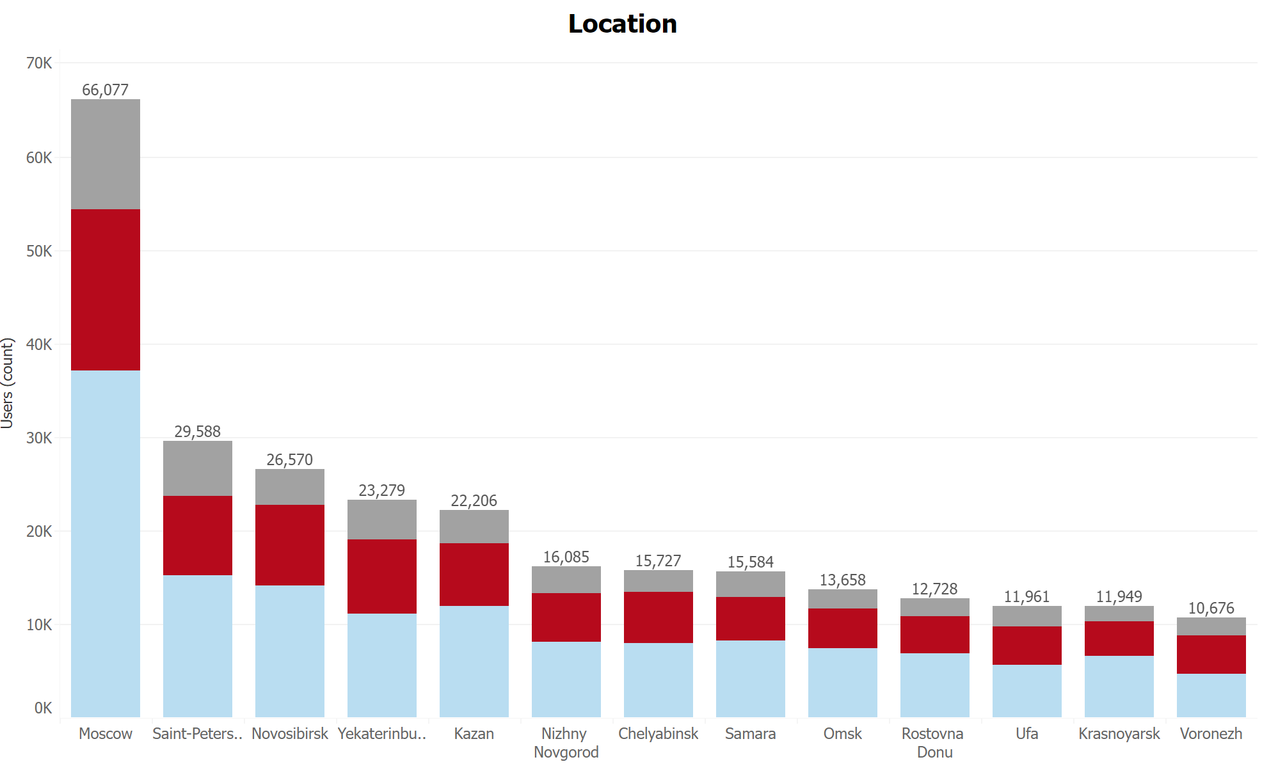

Slide 17
the five main cities taking part: Moscow, St. Petersburg, Novosibirsk, Ekaterinburg, Kazan;
in big cities, promoters predominate;
as the number of respondents decreases, the ratio of promoters\detractors equalizes;
passives are the least common group among the absolute majority of cities;
Conclusions:

Slide 18
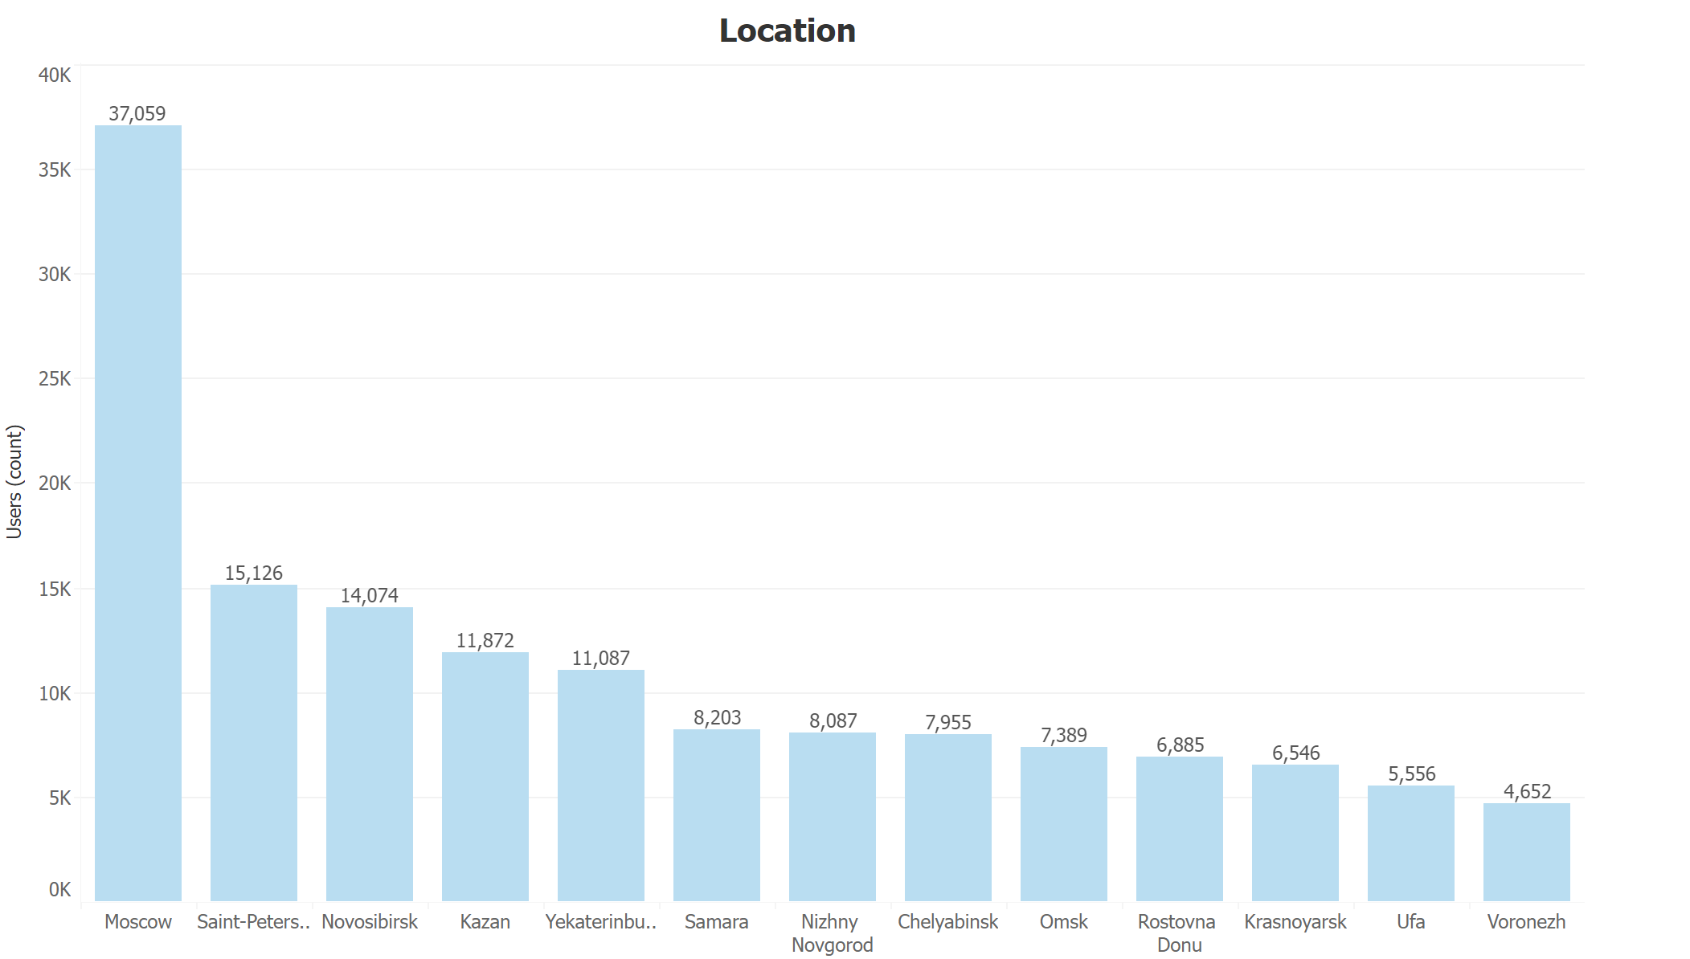
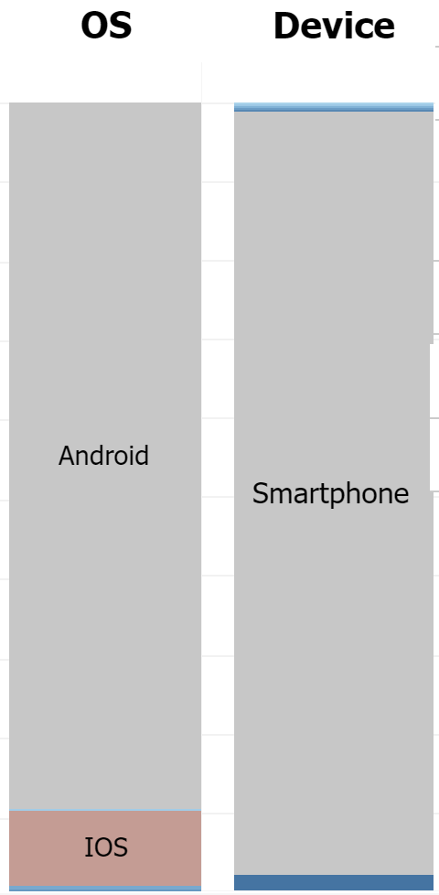
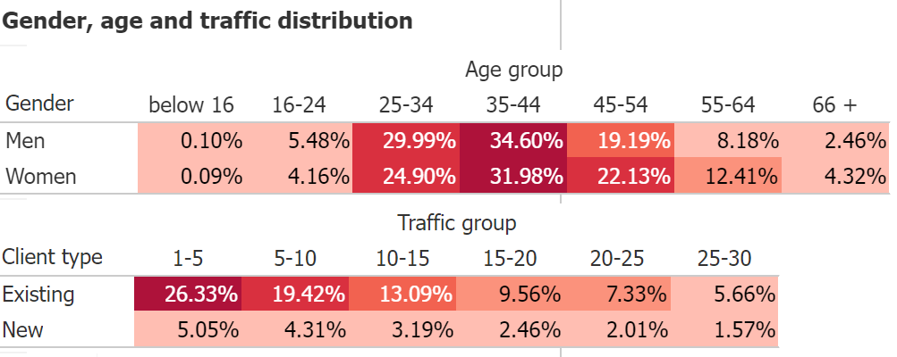
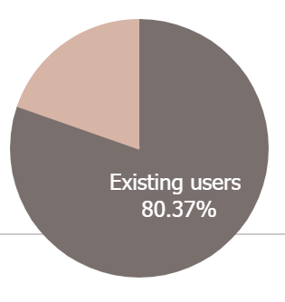
Promoters

Slide 19
over 95% of clients use smartphones;
main operating systems: Android and iOS;
the top 5 cities remain the same;
existing users ratio decreases from 82.87% to 80.37%;
the age range has expanded from 25 to 54 years;
the gender ratio remains the same;
Conclusions
(promoters):

Slide 20
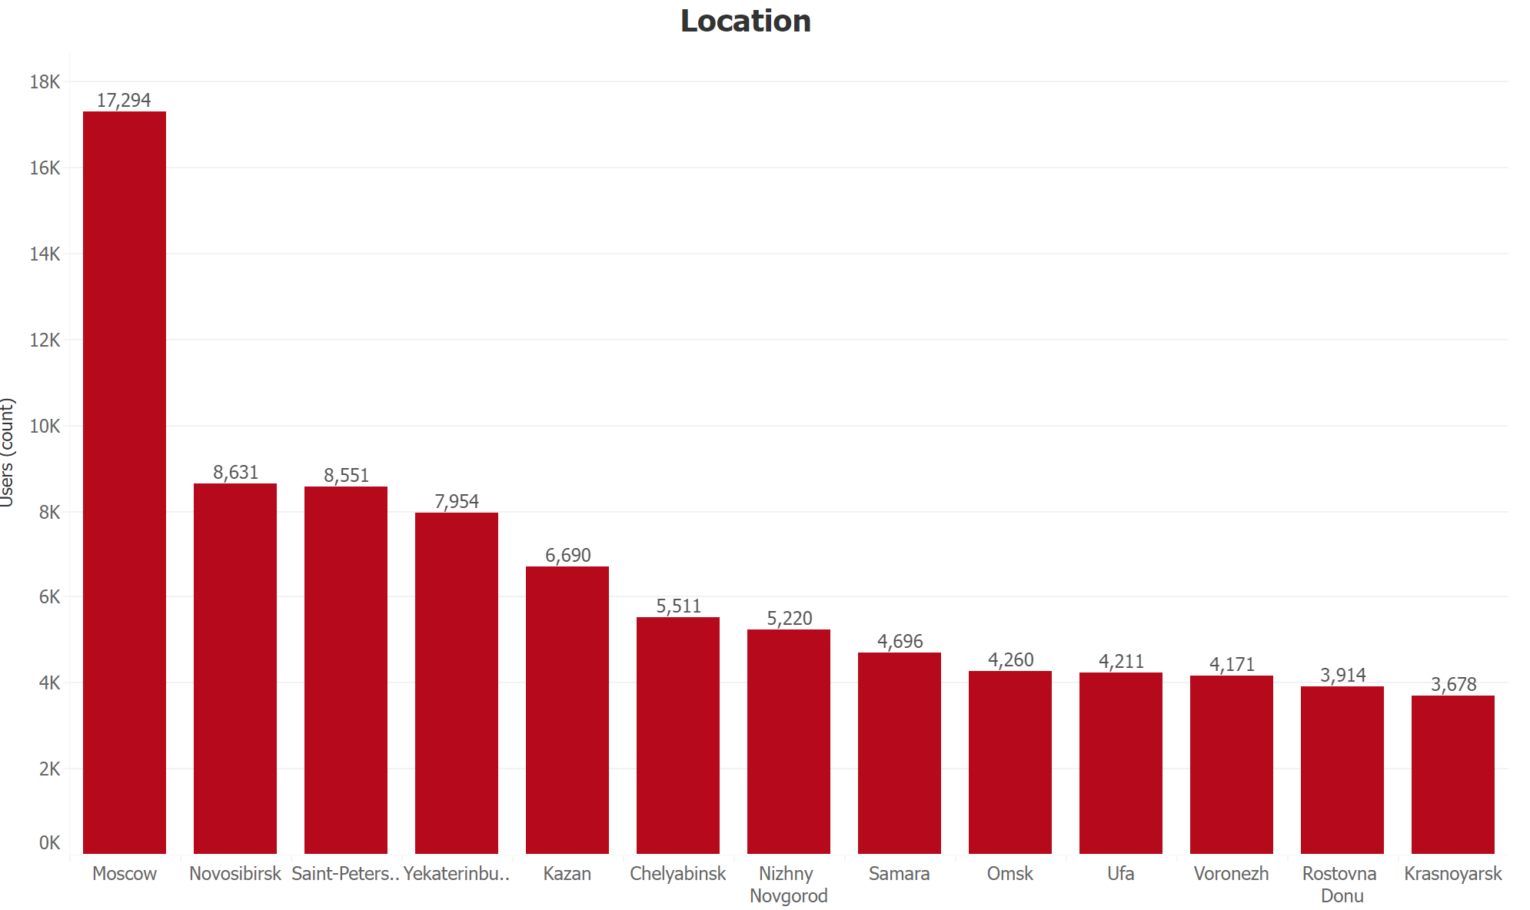
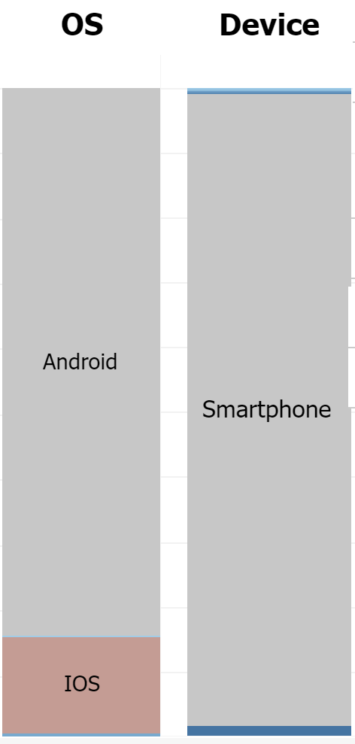
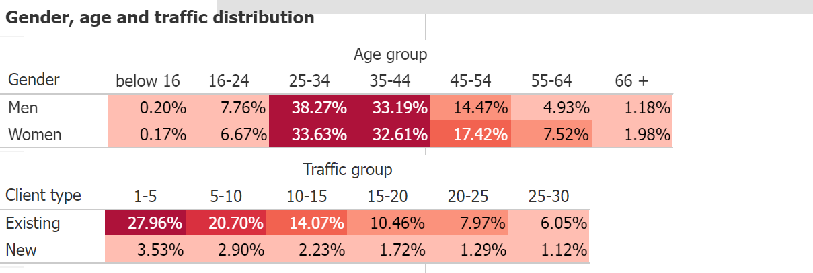
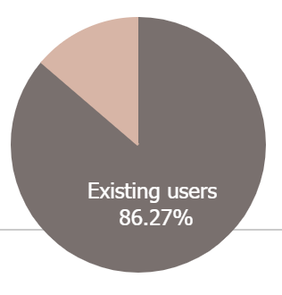
Detractors

Slide 21
over 95% of clients use smartphones;
main operating systems: Android and iOS, IOS ratio increases;
пятерка городов-участников идентична целой выборке (2nd place - Novosibirsk);
existing users ratio increases from 82.87% to 86.27%;
the age range : 25 – 54 with a left shift (25 - 34 years);
the gender ratio remains the same;
Conclusions
(detractors):

Slide 22
General conclusion
While the overall NPS service is satisfactory, it is necessary to work with the public, preferably with users aged 25-34 (one of the broadly represented groups with the lowest NPS).
While the lowest (and negative) NPS applies to younger age groups, these users represent less than 1% of all participants. The NPS is directly proportional to the increase of age (more than 50% among 66+ users).

Slide 23
General conclusion
Gender and score are less related, but overall women are more loyal to the company in all age groups.
Existing users - 82.87% of total respondents, their share decreases for promoters (to 80.37%) and increases (to 86.27%) for detractors.
The OS and device type, as well as the most common cities are approximately the same for all NPS groups.

Slide 24
General conclusion
In big cities, promoters predominate, as the number of respondents decreases, the ratio of promoters\detractors equalizes.
The main traffic groups 1-5 and 5-10 are identical for new and existing clients, regardless of the NPS group (detractors or promoters).

Slide 25

Feedback

